Slide 1
In vivo experimentation: An introduction
Kurt VanLehn

Slide 2
Outline
In vivo experimentation: Motivation & definition
3 examples
Reflection on the 3 examples
Distinguishing in vivo from other experiments
Quiz & discussion
IV track activities for rest of the week

Slide 3
What is the problem?
Need external validity
Address real instructional problems & content
Authentic students (e.g., backgrounds, pretraining)
Authentic context (e.g., motivations, social…)
Need internal validity
Control of variables to avoid confounds
E.g., instructor effects

Slide 4
Two most popular experimental methods
Laboratory experiments
Classroom experiments

Slide 5
Lab experiments
Students
Volunteers (recruited from classes?)
Motivated by money (or credit in psych course)
Context
Instruction done in a lab (empty classroom?)
Experimenter or software does the instruction
Maximum of 2 hours per session
Typical design
Pre-test, instruction, post-test(s)
Conditions differ in only 1 variable/factor
High internal validity; low external validity

Slide 6
Classroom experiments
Participants & context
Students from real classes
Regular instructors (not experimenter) does teaching
Design
Train instructors to vary their instruction
Observe classes to check that manipulation occurred
Assess via embedded pre- and post-test(s), or video
High external validity; low internal validity
Weak control of variables

Slide 7
In vivo experimentation
Goals
Internal validity
External validity

Slide 8
In vivo experimentation
Students and context
In a real classroom with real students, teachers
Software controls part of instruction
In-class and/or homework exercises
Records all interactions (= log data)
Design
Manipulation
Software’s instruction differs slightly over a long period, or
More dramatic difference during one or two lessons
Assessment via regular class tests & log data

Slide 9
Outline
In vivo experimentation: Motivation & definition
3 examples
Reflection on the 3 examples
Distinguishing in vivo from other experiments
Quiz & discussion
IV track activities for rest of the week
Next

Slide 10
1st example: Wang, Lui & Perfetti’s Chinese tone learning experiment
Context
CMU Chinese course
On-line exercises
Given spoken syllable, which tone (of 4) did you hear?
Very difficult to learn
Hypothesis
Earlier work → subtle wave form differences exist
Does displaying them help?

Slide 11
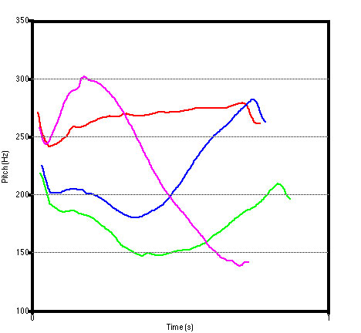
Chinese tones
/ma/ 1: ‘mother’
/ma/ 2: ‘linen’
/ma/ 3: ‘horse’
/ma/ 4: ‘scold’
Tone number
Pinyin

Slide 12
Design
Conditions
All conditions select tone from menu
All conditions given sound +…
Experiment: wave form & Pinyin
Control 1: number & Pinyin
Control 2: wave form
Procedure
Pre-test
One exercise session per week for 8 weeks
Several post-tests

Slide 13
Preliminary results
Error rates during training
Experiments < Controls on lessons 2, 5, 6 & 7
Pre/Post test gains
Experiments > Control 1 on some measures
Control 2 – too few participants
Tentative conclusion
Displaying waveforms increases learning
Second semester data being analyzed
Other data being analyzed

Slide 14
Why is this an in vivo experiment?
External validity
Real class, student, teachers
Post-tests counted in students’ grades
Cramming?
Internal validity
Varied only two factors: waveform, Pinyin
Collected log data throughout the semester
Who actually did the exercises?
Error rates, error types, latencies
Student profiles

Slide 15
2nd example: Bob Hausmann’s first experiment
The generation hypothesis: self-explanation > instructional explanation
Quick—f___ > Quick—fast (Slameka & Graf, 1978)
The fat man read about the thin ice. (Bransford et al.)
How can a worm hide from a bird? (Brown & Kane)
The coverage hypothesis: self-explanation = instructional explanation
Path-independence (Klahr & Nigam, 2004)
Multiple paths to mastery (Nokes & Ohlsson, 2005)
Variations on help (Anderson et al., 1995)

Slide 16
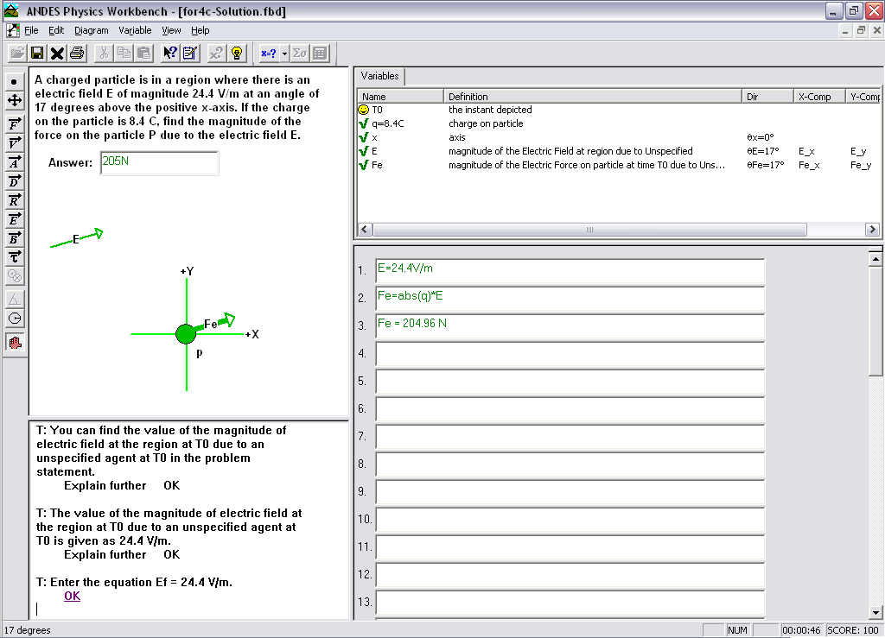
Variable q defined for charge
Help request buttons
Equation: Fe = abs(q)*E
Force due to Electric Field
Electric Field
Immediate Feedback via color
Bottom-out
hint
Notes:
Here is a screenshot of the Andes interface.
Highlight:
Draw vectors (E, Fe)
Define scalars (q)
Write equations (Def. of EF)
Get help: BOH

Slide 17
Terminology
Example = problem + multi-entry solution
Complete example = explains every entry
“Because the force due to an electric field is always parallel to the field, we draw Fe at 17 degrees. It’s in this direction because the charge is positive. If it had been negative, it would be in the opposite direction, namely 197 degrees.”
Incomplete example = no explanations of entries
“We draw Fe at 17 degrees.”

Slide 18
4 conditions
 | Prompted to paraphrase | Prompted to self-explain
Incomplete Example (each entry presented without explanation)
Complete Example (explains each entry)
Notes:
Attrition: originally had access to 113 mids, 7 ~consent, 2 absent = 104 total
Deviation: did not follow directions by opening out of order and not watching the videos.
However, authentic classroom—students avail themselves of the instructional materials. Need the gating procedure due out this fall in OLI.
Incomplete examples: created by deleting the justification for the application of a knowledge component.

Slide 19
Predictions
 | Prompted to paraphrase | Prompted to self-explain
Incomplete Example (each entry presented without explanation) | No explanation → no learning | Self-explanation → learning
Complete Example (explains each entry) | Instructional explanation → ???? | Self-explanation → learning
Generation hypothesis: No learning
Coverage hypothesis: Learning
Notes:
Attrition: originally had access to 113 mids, 7 ~consent, 2 absent = 104 total
Deviation: did not follow directions by opening out of order and not watching the videos.
However, authentic classroom—students avail themselves of the instructional materials. Need the gating procedure due out this fall in OLI.
Incomplete examples: created by deleting the justification for the application of a knowledge component.

Slide 20
Procedure: Each problem serves as a pre-, mid- or post-test
Example1
Example2
Example3
Self-explain
Complete
Self-explain
Complete
Self-explain
Complete
Self-explain
Incomplete
Self-explain
Incomplete
Self-explain
Incomplete
Problem1
Problem2
Problem3
Problem4
Paraphrase
Complete
Paraphrase
Complete
Paraphrase
Complete
Paraphrase
Incomplete
Paraphrase
Incomplete
Paraphrase
Incomplete
Notes:
I wish I had a picture of this, but we put a headphones with a noise-cancellation microphone on 24 mids in one laboratory.
The problem simultaneously posttests the previous concepts & pretests the next set of concepts.

Slide 21
In the Physics LearnLab: Spring semester 2006 at the USNA
Normal instruction for several weeks
Including use of Andes for homework
Hausmann’s study during a 2-hour physics lab period
Normal instruction for several more weeks
Craig’s study, also during a 2-hour lab period
Normal instruction for several more weeks

Slide 22
Dependent measures
Log data from problem solving
Before, during and after the manipulation
Errors
Help requests
Bottom-out hints
Ditto, but main principle only
Learning curves
Audio recordings of student’s explanations
Midterm exam
25 students all talking into headset mikes

Slide 23
One measure: Help requests
Supports the generation hypothesis: Instructional explanation→ little learning
Notes:
DV:WWH ME:SE<PP Gen Hyp
CPP > CSE
IPP >= CSE

Slide 24
3rd example: Butcher, Aleven et al. geometry study
Hypothesis
Splitting visual attention harms learning.
Geometry Cognitive Tutor: 2 conditions
Entries in the diagram: Keeps attention in diagram
Entries in a table: Splits attention

Slide 25
Table Condition splits attention

Slide 26
Diagram Condition keeps attention in diagram

Slide 27
Preliminary Results: Transfer
3-way interaction: Test Time * Condition * Ability:
F (1, 38) = 4.3, p < .05

Slide 28
Outline
In vivo experimentation: Motivation & definition
3 examples
Reflection on the 3 examples
Distinguishing in vivo from other experiments
Quiz & discussion
IV track activities for rest of the week
Next

Slide 29
Methodological variation: Duration of training
Wang: Whole semester
Hausmann: 2 hour lab session
Butcher: 3 week unit on circles

Slide 30
Methodological variation: Condition assignment
Wang: Between sections
Different sections get different treatments
All students in a section assigned to same treatment
Hausmann & Butcher: Between subjects
Different students assigned to different treatments
All sections have all conditions
Others: Within subjects
Same student gets different treatments at different times
All students are in all conditions

Slide 31
Relationship of experimenter’s software to course’s tutoring system
Wang’s software
replaced course’s tone-drill software
Hausmann
Did not develop software
Used 4 different video tapes, one per condition
Experimental activities replaced a physics lab activity
Butcher’s software
Variation of Carnegie Learning’s tutoring system
Designed by Butcher et al.
Implemented mostly by Carnegie Learning
Replaces course’s normal software

Slide 32
Outline
In vivo experimentation: Motivation & definition
3 examples
Reflection on the 3 examples
Distinguishing in vivo from other experiments
Quiz & discussion
IV track activities for rest of the week
Next

Slide 33
How does in vivo experimentation differ from course development?
Research problem to be solved
Primary: “An open question in the literature on learning is …”
Secondary: “One of the hardest things for students to learn in <class> is …”
Scaling up not necessary
One unit of curriculum may suffice
Sustainability not necessary
OK to use experimenter instead of technology

Slide 34
How does in vivo experimentation differ from lab experimentation?
Instructional objectives and content
Already taught in course, or
Negotiated with instructor
Control group must receive good instruction
Logistics
Timing – only one opportunity per semester/year
Place
Participation not guaranteed
Count toward the student’s grade?

Slide 35
How does in vivo differ from other classroom experimentation?
Superficial differences
Treatment implemented by training teachers
And observing whether they teach as trained
Or better!
Can only do between-section, not between-student
Control groups are often absent or weak
Underlying difference
Granularity of the hypotheses and manipulations
See next few slides

Slide 36
An example of a large-grained classroom experiment: PUMP/PAT
Early version of CL Algebra (Koedinger et al.)
Tutoring system (PAT)
Curriculum (PUMP) including some teacher training
Whole year
Hypothesis
PUMP/PAT is more effective than conventional instruction

Slide 37
A 2nd example of large grained classroom experiments: CECILE
CECILE (Scardamalia, Bereiter et al.)
Networked collaborative learning software
Long, complex math activities done in small groups
Developed and published on the web
Whole year
Hypothesis
CECILE community of learning increases gains

Slide 38
A 3rd example of large grained classroom experiments: Jasper
Anchored instruction (Bransford et al.)
“Jasper” video provide a vivid, shared anchor
Long, complex math activities tied to anchor
Whole year
Hypothesis:
Anchored instruction prevents inert knowledge

Slide 39
Outline
In vivo experimentation: Motivation & definition
3 examples
Reflection on the 3 examples
Distinguishing in vivo from other experiments
Quiz & discussion
IV track activities for rest of the week
Next

Slide 40
How would you classify this classroom experiment?
Reciprocal teaching (Palinscar & Brown)
Small, teacher-led groups
Students trained two switch roles with teacher & each other
Multiple weeks
Hypothesis: Reciprocal teaching is more effective than normal small group learning

Slide 41
How would you classify this classroom experiment?
Andes tutoring system (VanLehn et al.)
Homework exercises done on Andes vs. paper
Same exercises, textbook, labs, exams, rubrics
Whole semester
Hypothesis:
Doing homework problems on Andes is more effective than doing them on paper

Slide 42
How would you classify this experiment? (Lui, Perfetti, Mitchell et al.)
Normal drill (used as pretraining)
Present Chinese character (visual) and pronunciation (sound)
Select English translation. Get applauded or corrected
Manipulation
Select English translation. No feedback.
Present character, pronunciation, both or neither
Co-training hypothesis
Drill with both character and pronunciation > drill with either character or pronunciation (not both) > no extra drill at all
Pull out

Slide 43
Should this experiment be redone in vivo? (Min Chi & VanLehn)
Design
Training on probability then physics
During probability only,
Half students taught an explicit strategy
Half not taught a strategy (normal instruction)
Preparation for learning
Score
Score
Ordinary transfer
Pre
Post
Pre
Post
Probability Training
Physics Training

Slide 44
Outline
In vivo experimentation: Motivation & definition
3 examples
Reflection on the 3 examples
Distinguishing in vivo from other experiments
Quiz & discussion
IV track activities for rest of the week
Next

Slide 45
Your job: Simultaneously design 3 elements of an in vivo experiment
A hypothesis
Fits into literature on learning
High information value (in Shannon’s sense)
A context
unit of the curriculum & instructional objective
training content and assessments
A manipulation
Tests the hypothesis
Fits well in the context

Slide 46
Schedule
Tuesday
AM: Become familiar with course & tutoring system
Early PM: Become familiar with theory
Late PM: Start writing Letter of Intent (2 pgs)
State background lit, hypothesis, context, manipulation
Wednesday AM
Letter of Intent (LOI) due 10:45 am
Feedback from course committee representatives
Wednesday PM & Thursday
Revise design, add details, write proposal & slides
Friday
Presentation

